Slide 1


April 3rd
Lehigh University
Teaching Demo
Introduction to Diffusion
in Materials Science
Menglin Zhu
Department of Materials Science & Engineering
Massachusetts Institute of Technology
Class Materials
Topics:
Random movement of particles: Brownian motion
Steady state diffusion: Fick’s 1st law
Non steady state diffusion: Fick’s 2nd law
Notes:
TEM

Slide 2

Diffusion: To Spread Out
Diffusion
Dye
Molecule
Equilibrium
High
Low Concentration
Movement of particles from an area of higher concentration to an area of lower concentration, until equilibrium is reached.

Slide 3
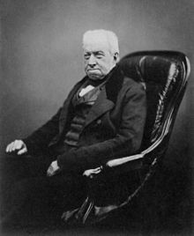
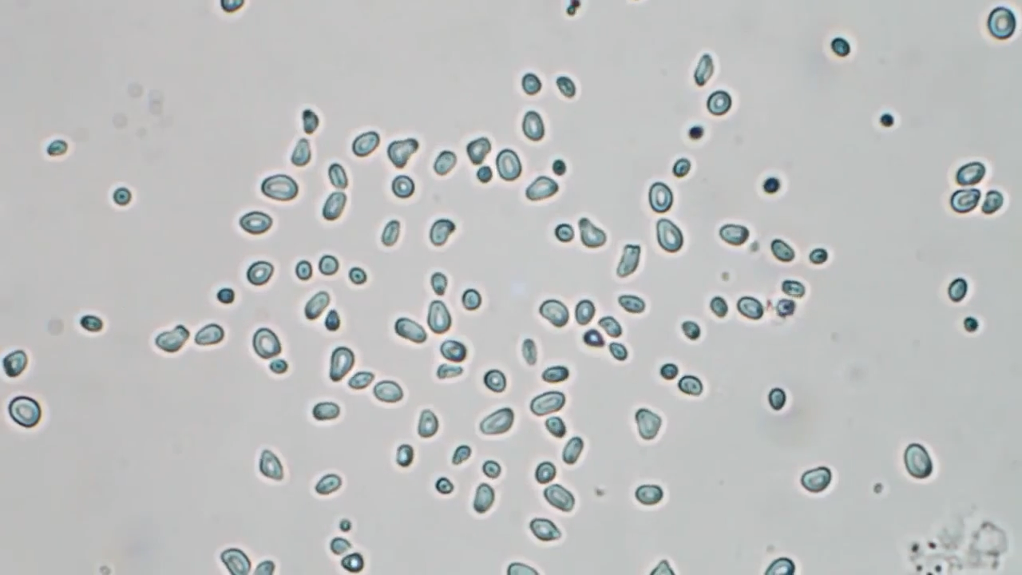
Brownian Motion
Robert Brown
Botanist, 1827
Pollen of plants in water
Related to the the particles being Alive?
“These [Brownian] motions were such as to satisfy me, after frequently repeated observation, that they arose neither from currents in the fluid, nor from its gradual evaporation, but belonged to the particle itself.”
Microscopic basis for diffusion

Slide 4
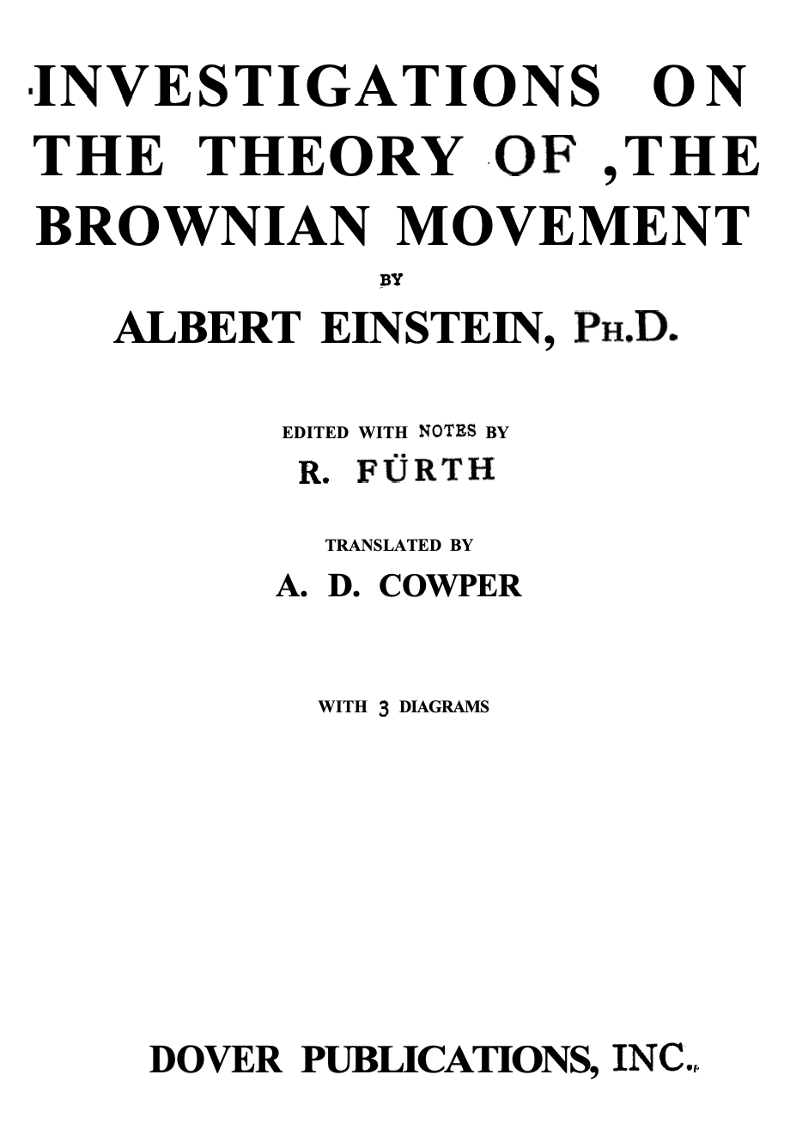
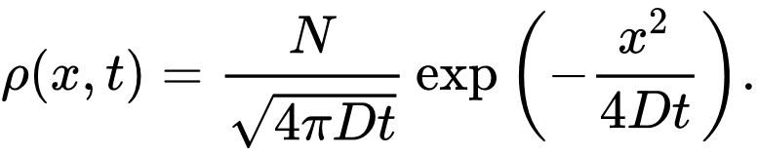
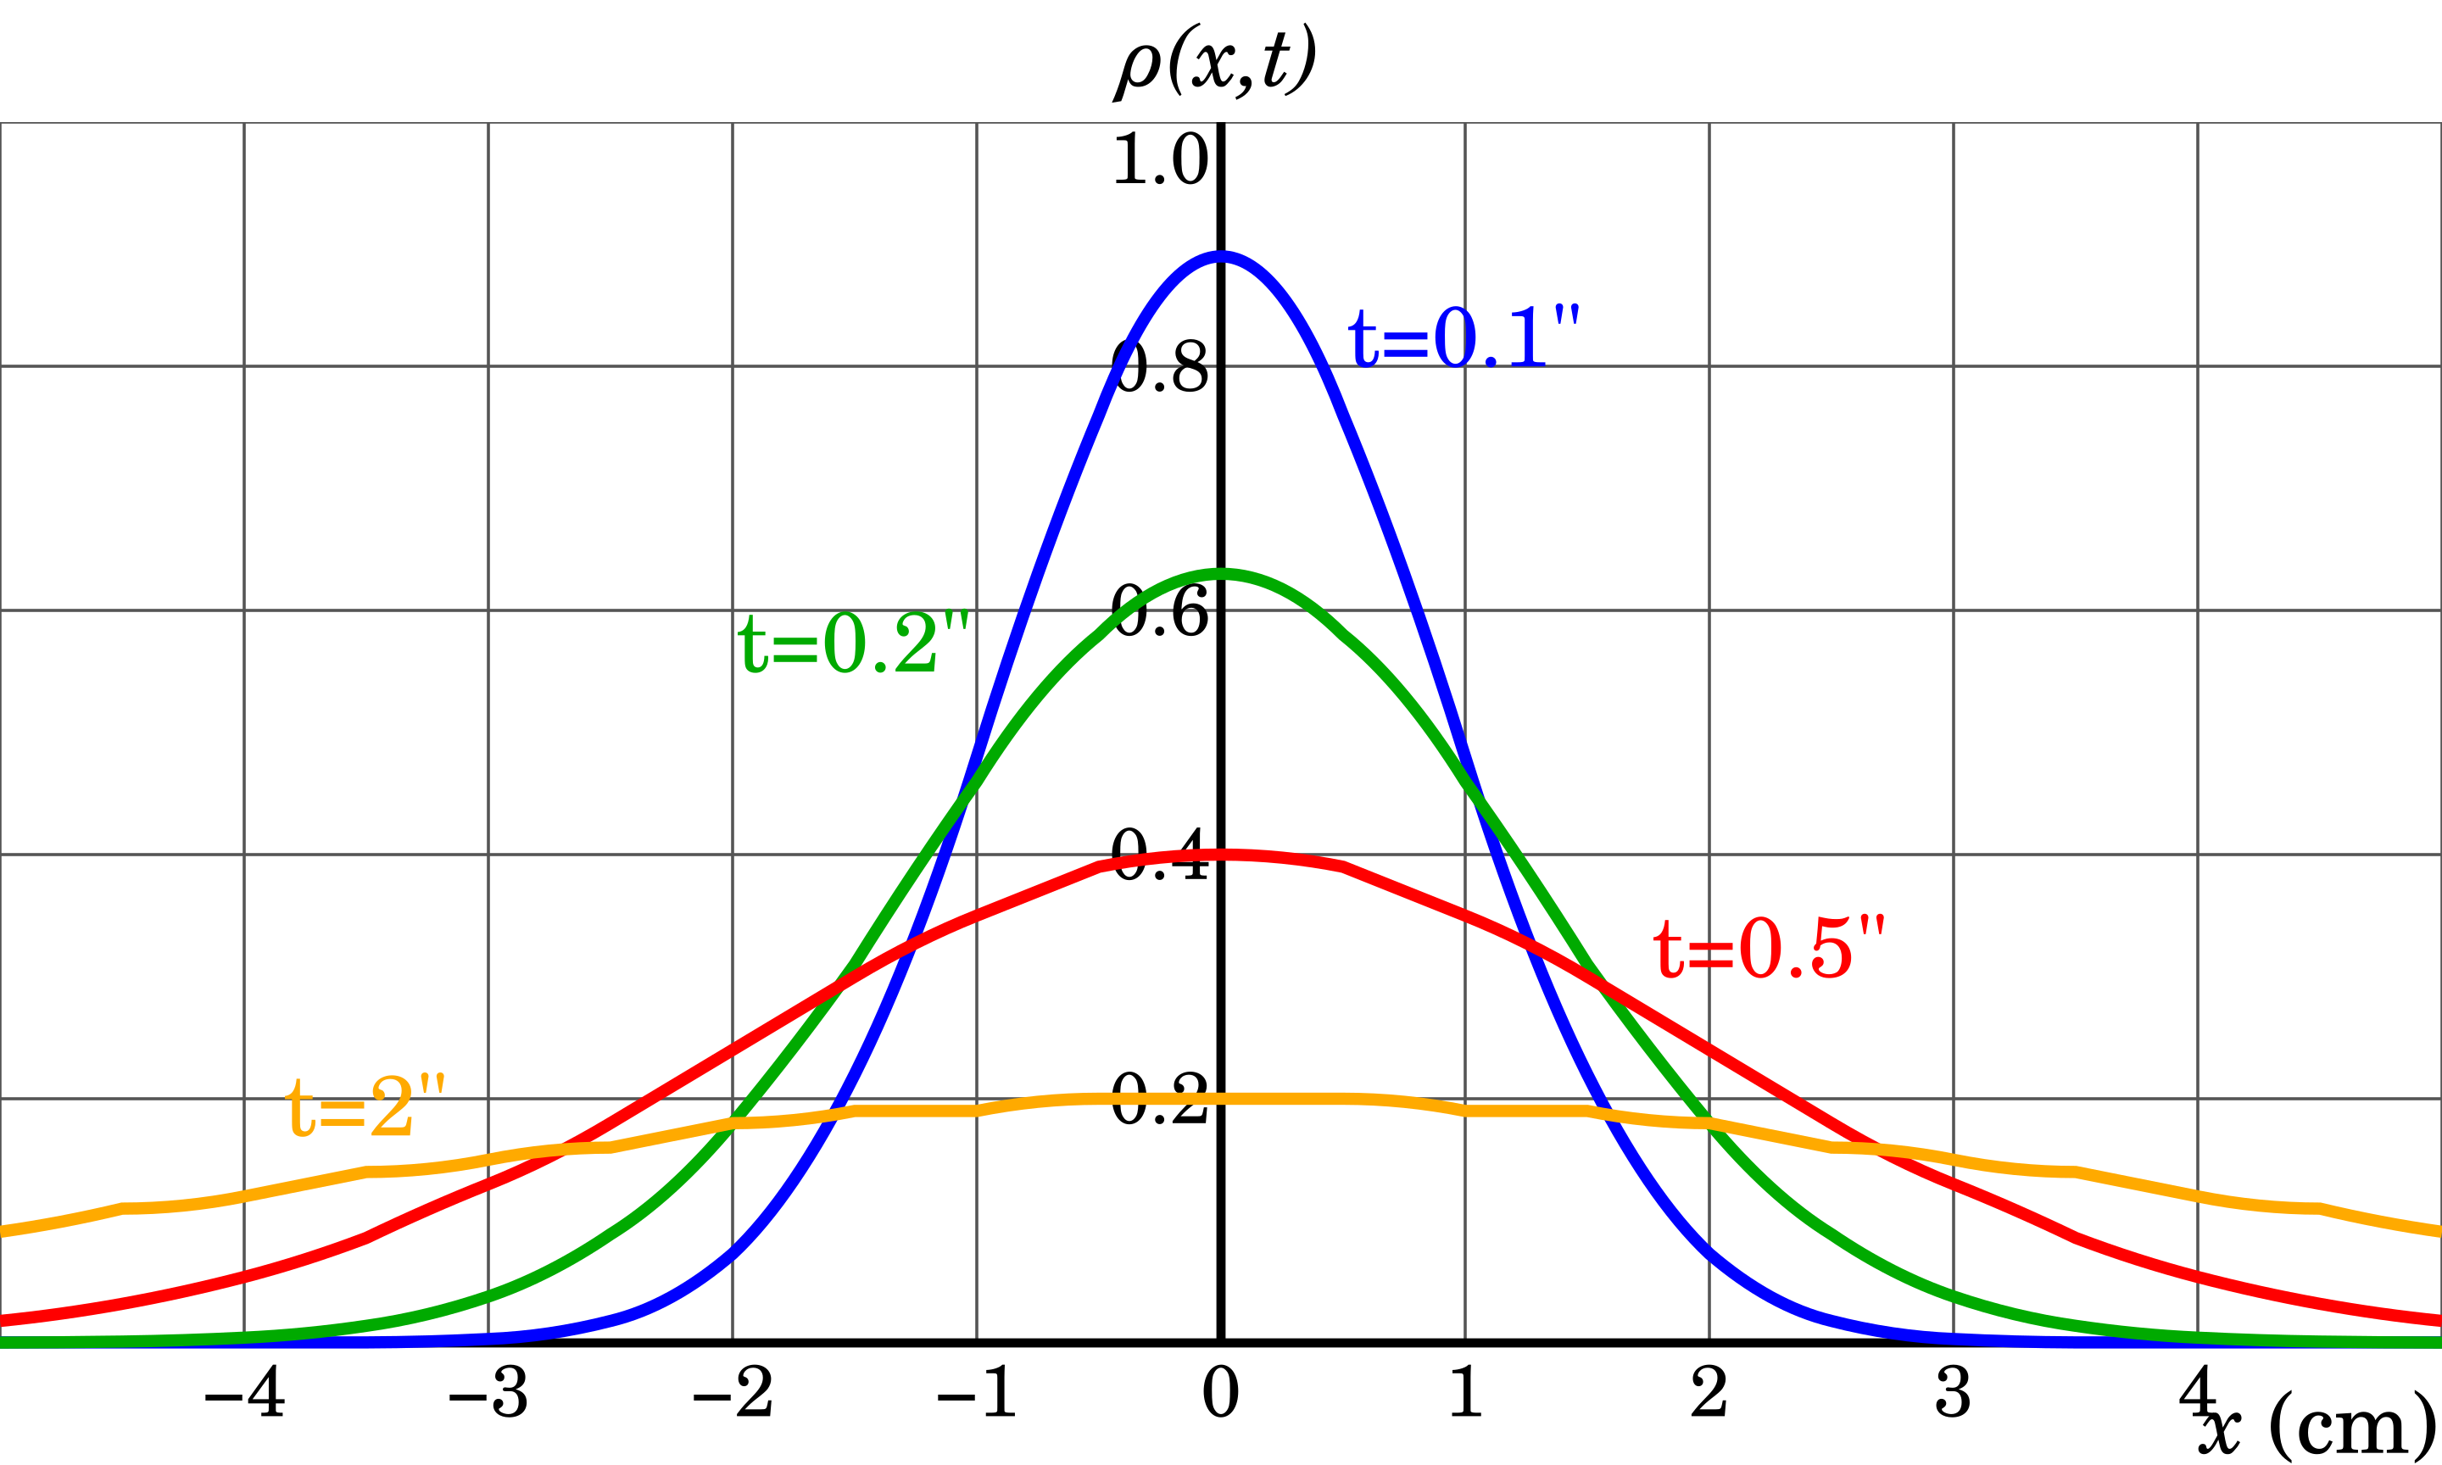
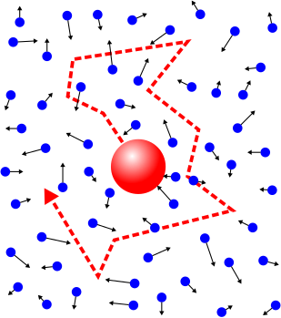

“A New Determination of Molecular Dimensions”
Einstein, 1905 Thesis
Each movement is independent and random, where is the particle after time t?
How far it travels on average?
Variance of the normal distribution
$$\left\langle x^{2}\right\rangle =2Dt$$

Slide 5
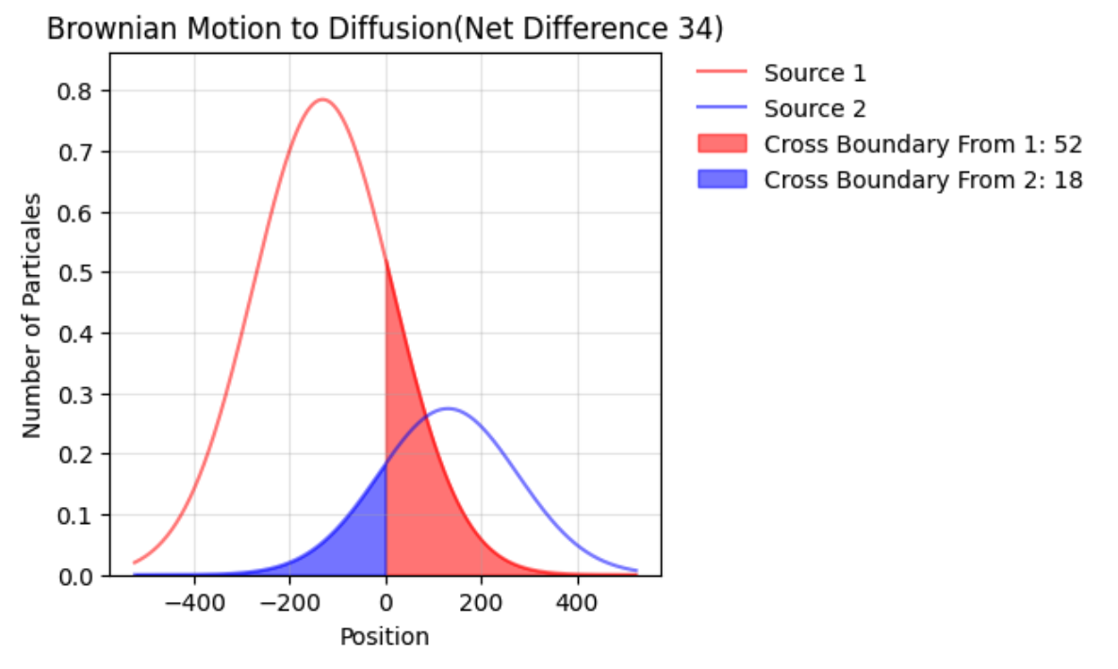

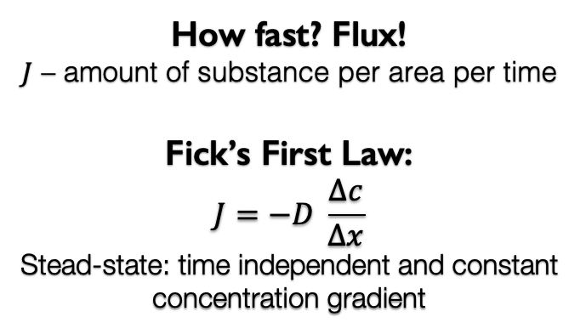
Steady State Diffusion: Fick’s 1st Law (1855)
How does random Brownian motion leads to directional diffusion?
Difference in concentration
How fast? Flux!
$J$ – amount of substance per area per time
Fick’s First Law:
$$J=−D \frac{∆c}{∆x}$$
Stead-state: time independent and constant concentration gradient
How fast? Flux!
$$J$$

Slide 6

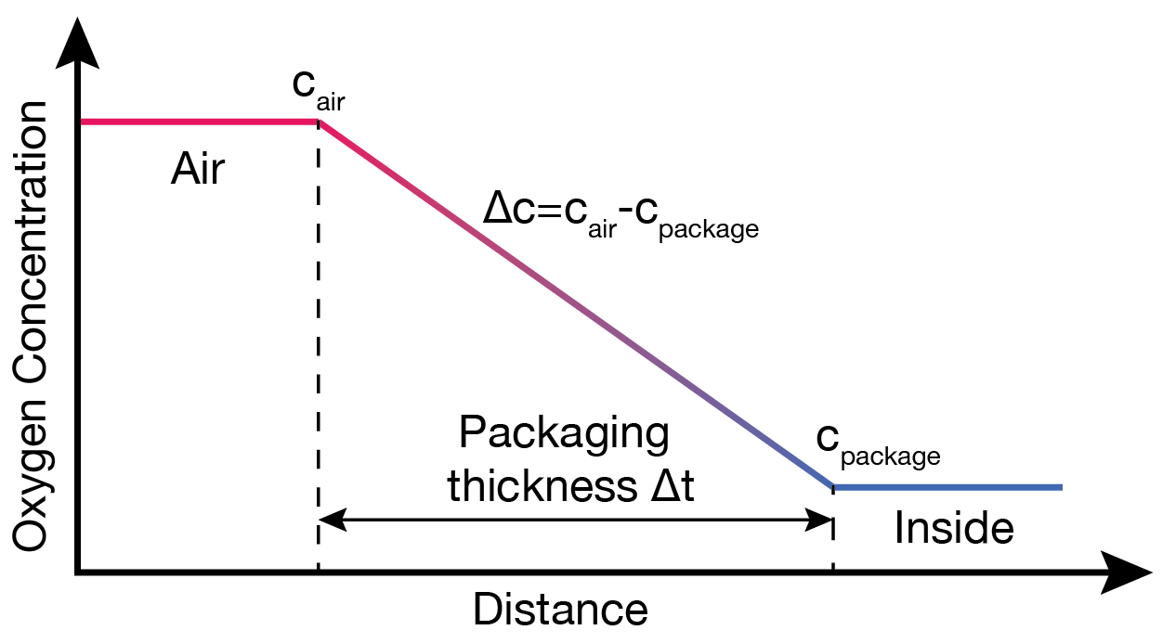
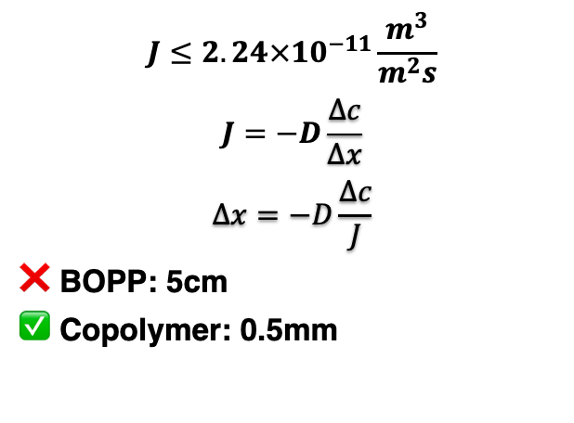
Fick’s First Law for Potato Chips
~21% O₂
Package volume: 0.015 m³
Surface area: 0.19 m²
<0.5% O₂
$$J≤2.24×10^{−11}\frac{m^{3}}{m^{2}s}$$
$$J=−D\frac{∆c}{∆x}$$
$$∆x=−D\frac{∆c}{J}$$
❌ BOPP: 5cm
✅ Copolymer: 0.5mm
Potato chips stale when oil get oxidized. We want to design a bag
Extend the shelf life (12-month)
Use minimal plastic

Slide 7

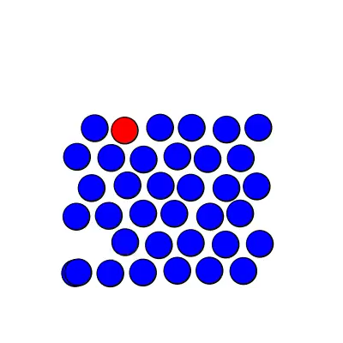
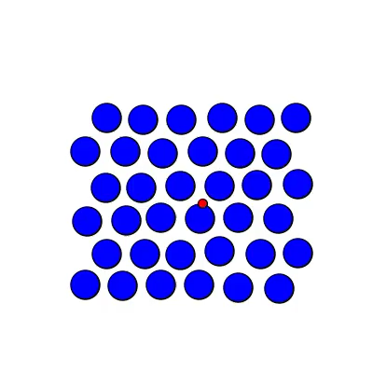
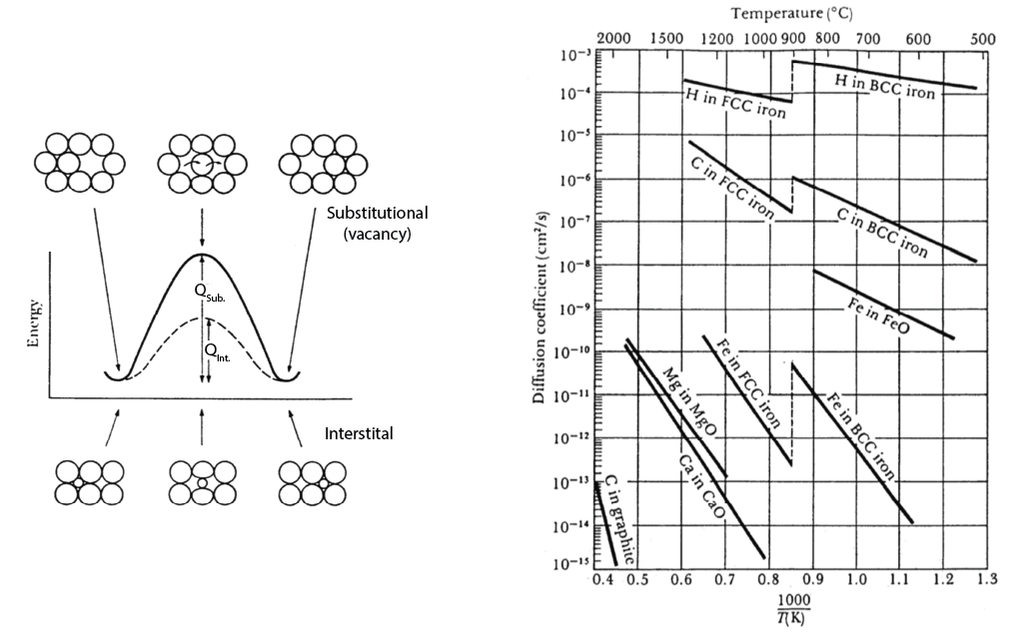
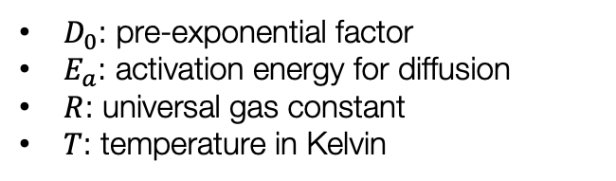
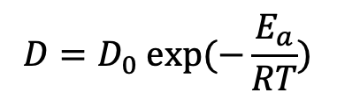
What does diffusivity D depend on?
Perfect Lattice
Substitution
+Vacancy
Interstitial
Temperature dependent reaction rates
Arrhenius equation
$$D=D_{0} exp⁡(−\frac{E_{a}}{RT})$$
$D_{0}$: pre-exponential factor
$E_{a}$: activation energy for diffusion
$R$: universal gas constant
$T$: temperature in Kelvin

Slide 8
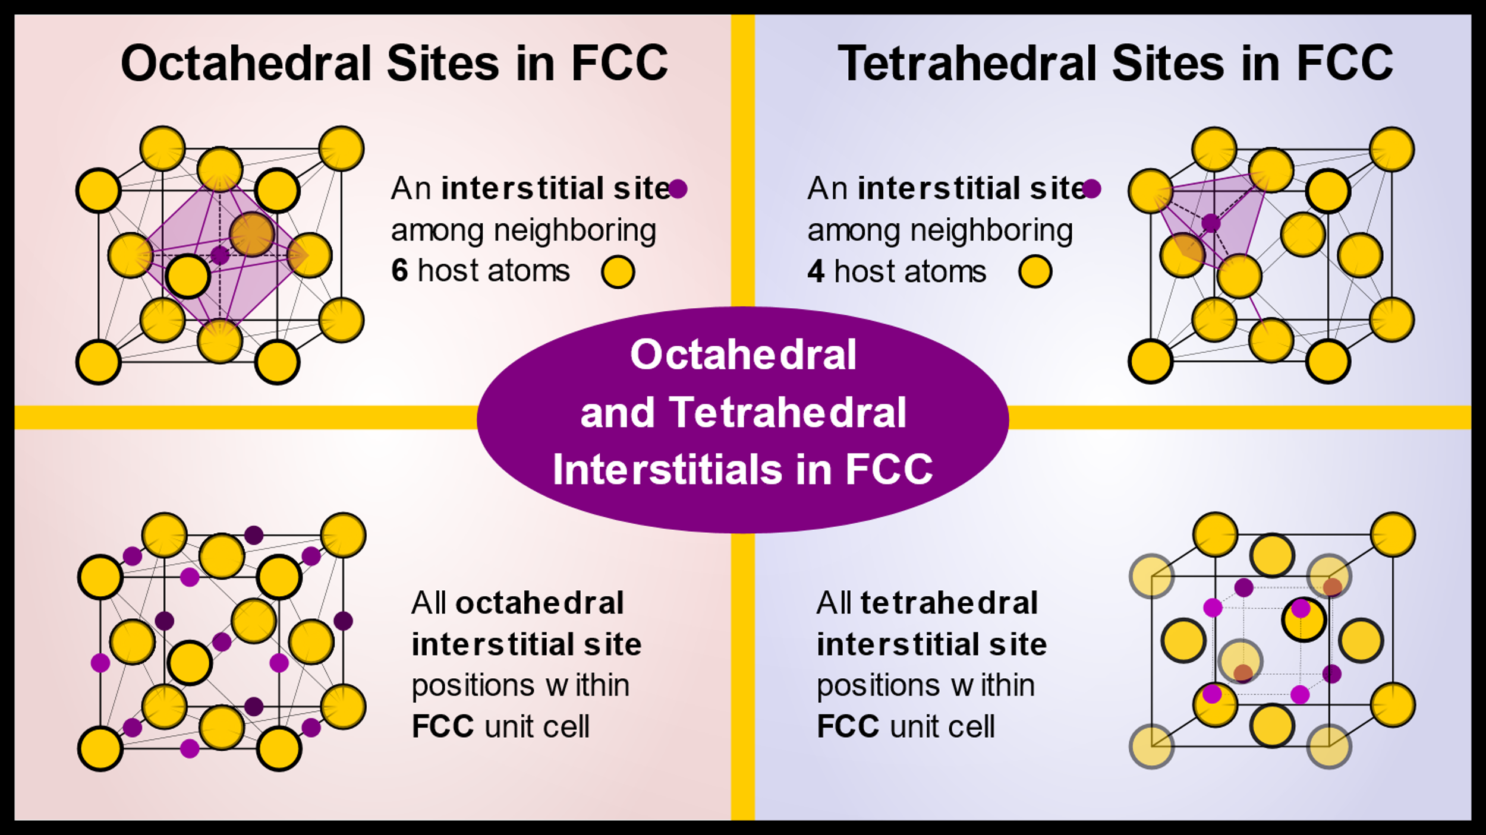
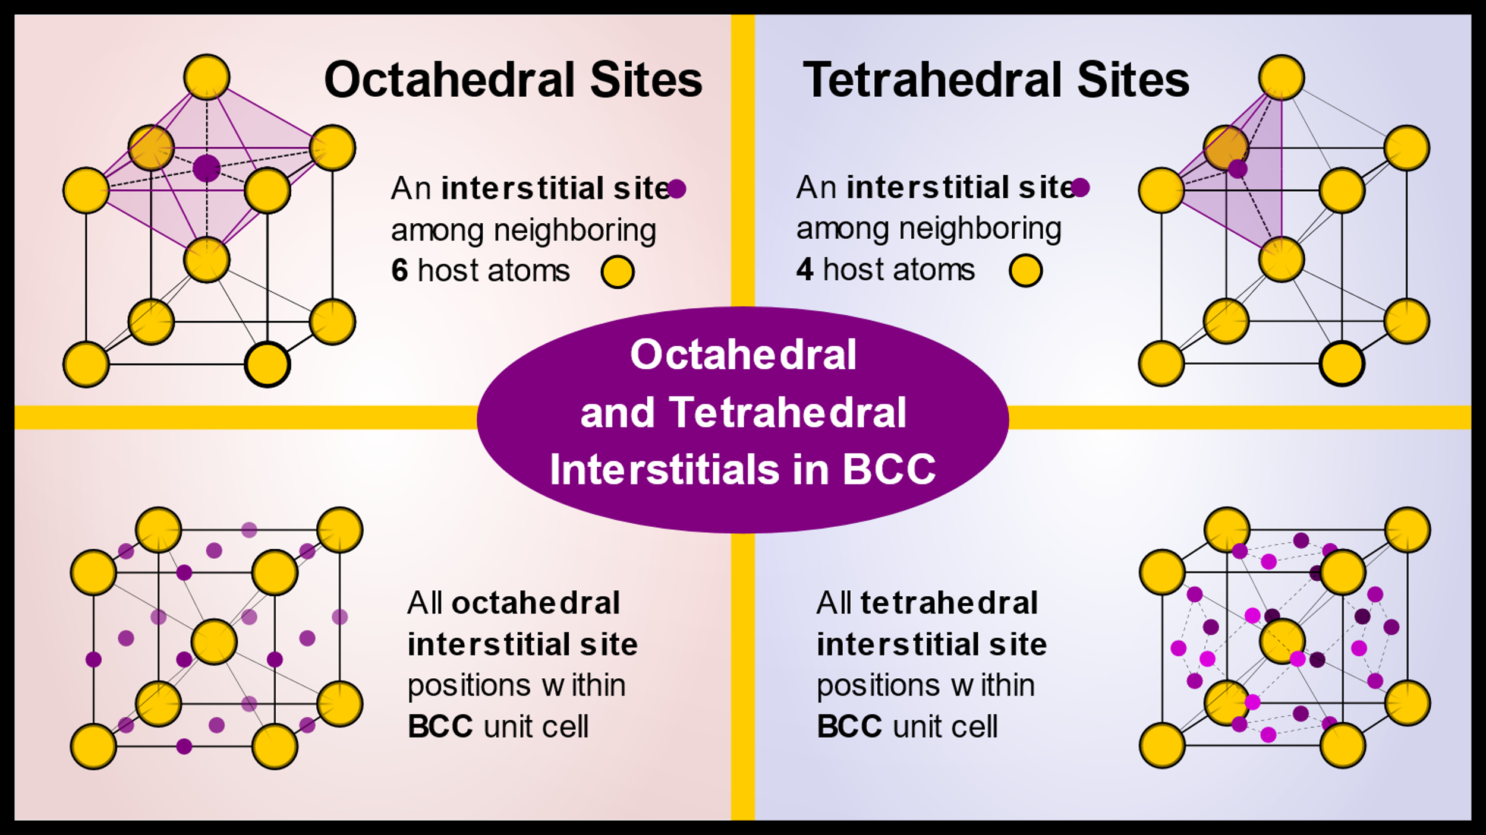
Diffusion through Interstitial Sites

Slide 9
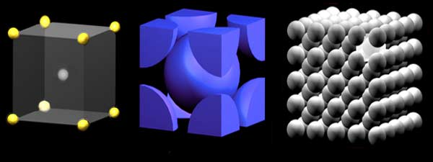
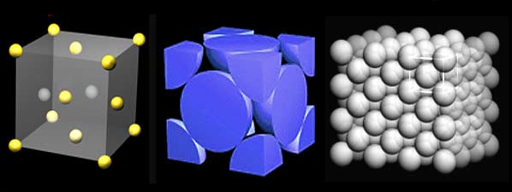
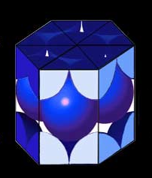
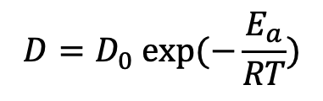
Diffusion in Crystal
$$D=D_{0} exp⁡(−\frac{E_{a}}{RT})$$
Among each pair, which is faster?
Carbon into α-Fe (BCC) or γ-Fe (FCC)
Fe in α-Fe at 500°C or at 900°C
C or H in α-Fe
Si vacancy in Si or He in Si
H in Pt (FCC) or H in Mg (HCP)
BCC 0.68
FCC 0.74
HCP 0.74

Slide 10
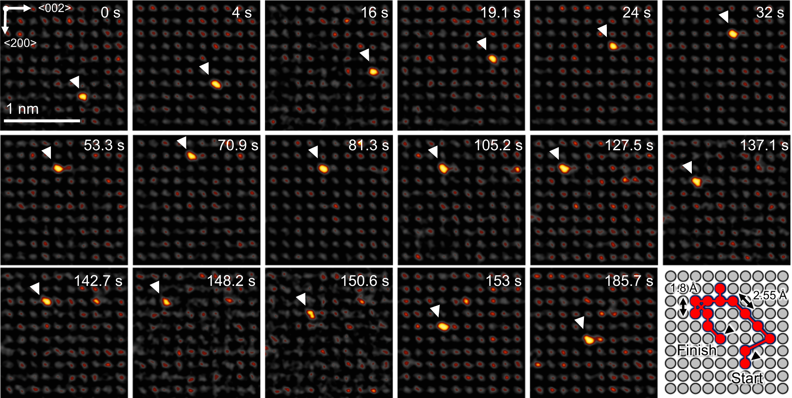

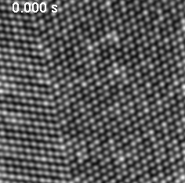
Diffusion in Action
Atomic scale volume and grain boundary diffusion elucidated by in situ STEM

